Slide 1
CAPSTONE PROJECT
Secure Data Hiding in Image Using Steganography
Presented By
Student Name : Uzair Meezan Siddiqui
College Name & Department : Suman Ramesh Tulsiani Technical Campus, Khamshet (Computer Engineering)

Slide 2
OUTLINE
Problem Statement
Technology used
Wow factor
End users
Result
Conclusion
Git-hub Link
Future scope

Slide 3
Problem Statement
This project focuses on embedding sensitive information within images using steganography. Unlike traditional encryption, which may draw attention, steganography discreetly hides data in the pixel values of images without changing their visual quality. The objective is to build an algorithm that securely embeds and extracts data while preserving image integrity.

Slide 4
Technology used
Libraries Used:
Standard Libraries: opencv, os, string
Custom Header: "steganography.h"
Platforms:
Operating System: Windows, Linux
Compiler: GCC
File Format: BMP (Bitmap Image)
Additional Points:
Steganography Method: Least Significant Bit (LSB) Encoding
Data Handling: Embeds and extracts text data from images

Slide 5
Wow factors
1️⃣ LSB-Based Steganography – Hides data in the Least Significant Bit, ensuring security without visible image changes.
2️⃣ Lossless BMP Processing – Works with uncompressed BMP images to maintain data integrity.
3️⃣ Lightweight & Fast – Written in C for high efficiency, outperforming Python/Java-based tools.
4️⃣ Simple CLI Interface – Easy command-line usage for embedding and extracting data, ideal for automation.

Slide 6
End users
1️⃣ Cybersecurity Professionals – Utilize steganography for secure communication and data protection.
2️⃣Privacy-Conscious Users – Protect personal information from unauthorized access.
3️⃣ Researchers & Academics – Develop advanced techniques in data security and cryptography...
4️⃣ Government & Defense Agencies – Safeguard sensitive information in covert operations.

Slide 7
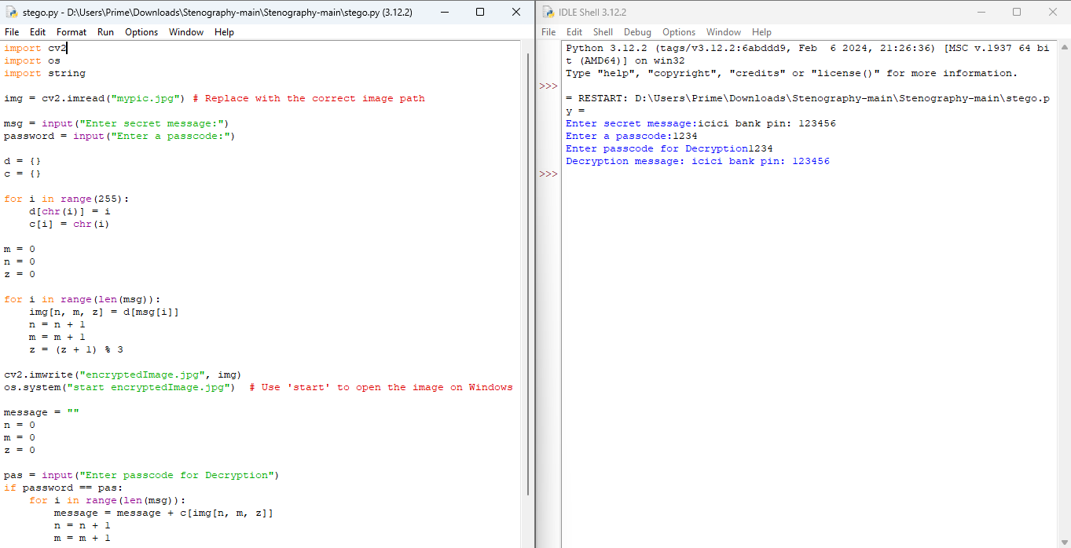
Results

Slide 8
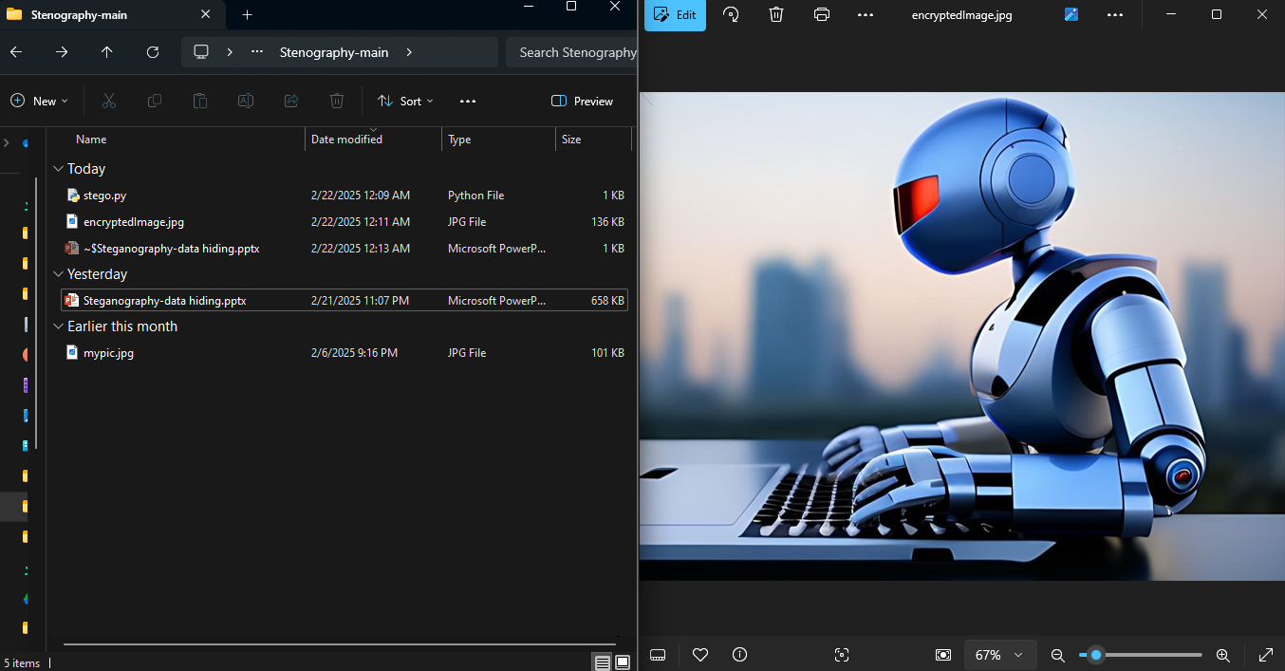

Slide 9
Conclusion
This project delivers a lightweight, efficient, and secure method for embedding data using LSB steganography. While optimized for BMP images, future developments can extend support to formats like PNG or employ more advanced methods such as DCT for JPEGs.

Slide 10
GitHub Link
https://github.com/siddquy2004/Stegnography_aicte.git
Repository Contents:
📂 Source Code – python programs for embedding and extracting hidden messages.
📂 Sample Images – BMP images used for testing steganography.
📂 Presentation – PPT slides summarizing the project.
📂 Documentation – Project report, explanations, and implementation details.

Slide 11
Future scope(optional)
🖥️ Graphical User Interface (GUI) – Develop a user-friendly GUI to make embedding and extracting messages easier.
📂 Drag and Drop Support – Allow users to select images and messages through a simple drag-and-drop interface.
🛠️ Customization Options – Provide settings for users to adjust the encoding method and choose different bit depths.
📊 Real-time Preview – Show a preview of the image before and after steganography is applied.

Slide 12
THANK YOU

